Slide 1
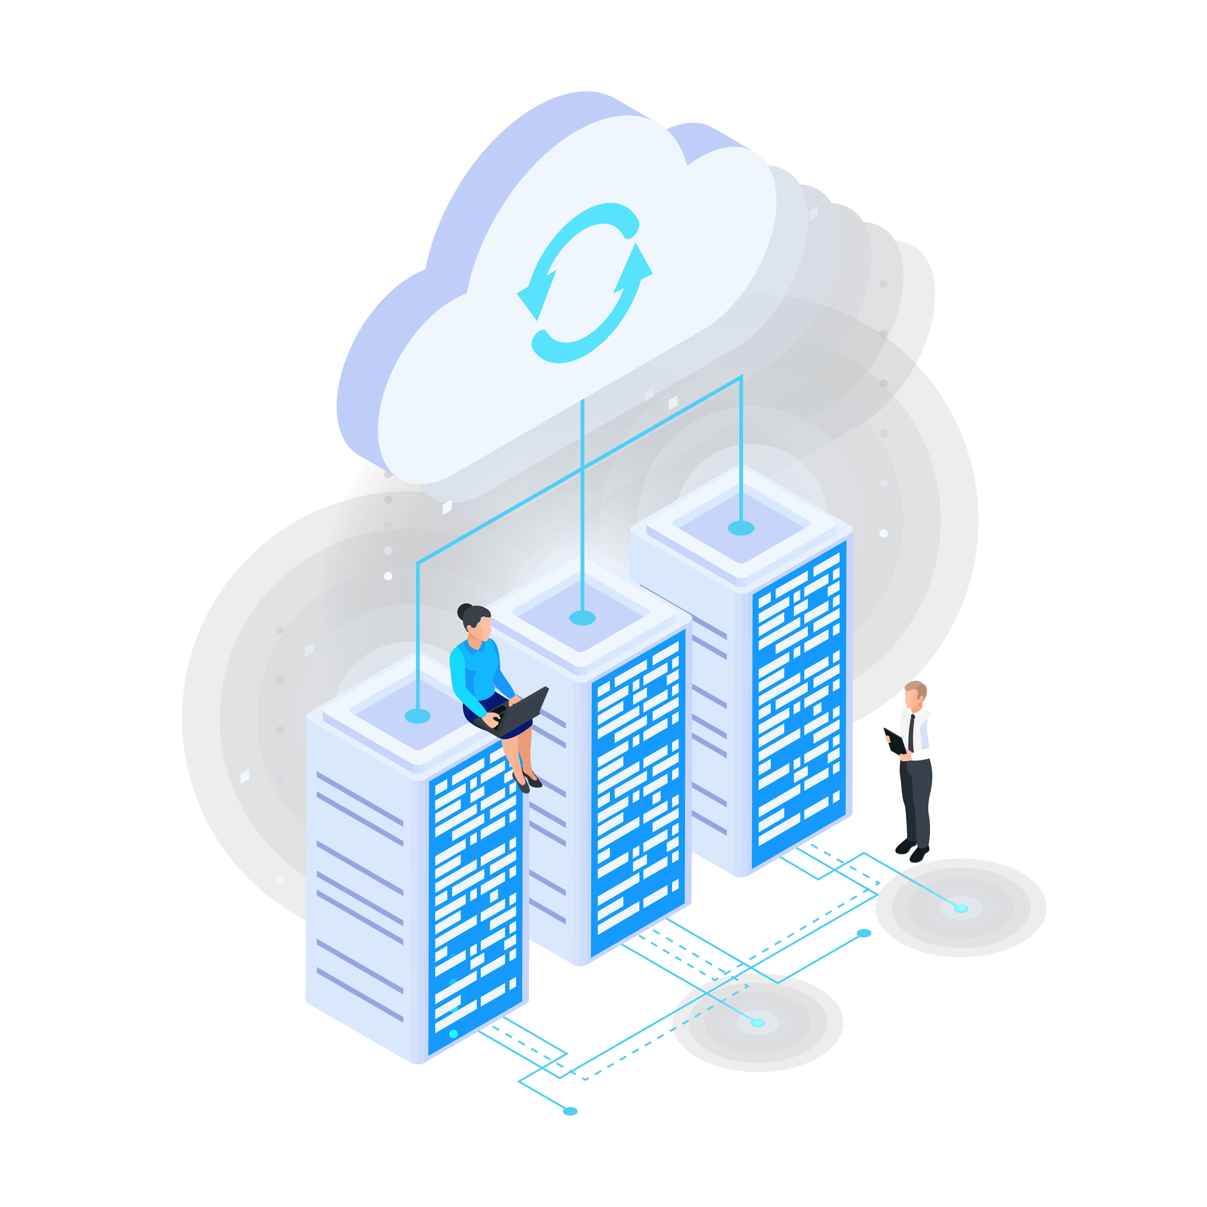
Cloud Migration of an E-Commerce Company
Subject Cloud Migration
Professor Islam Gomaa Group Members
Aliasgar Husain - 41161727
Catherine Daigle – 41175118
Abhinav - 41129125
Yash Rajput
Jimish Gajjar - 41174142

Slide 2
Introduction
Objective
To demonstrate a practical approach to cloud migration for an e-commerce company.
Focus on achieving scalability, improved performance, and operational cost reduction.
Key Aspects of the Presentation:
Resource Assessment:
Analysis of existing infrastructure, including VMs, databases, monolithic ERP systems, and mainframes.
Migration Strategy:
Phased approach to minimize risks, starting with non-critical systems to full modernization of mainframes.
Modernization Techniques:
Transition from monolithic architecture to microservices using Azure Kubernetes Service (AKS).
Integration of serverless technologies like Azure Functions for workflow automation.
Compliance & Security:
Encryption and backup strategies to protect data in transit and at rest.
Adherence to regulatory standards like CCCS and HIPAA.
Tools and Technologies Used:
Azure Migrate, Azure Database Migration Service, Azure Cost Calculator, and other Azure tools for seamless transition.
Outcome Expectations:
Enhanced system reliability and scalability.
Optimized resource allocation and cost-efficiency.

Slide 3
Migration Strategy
Assessment
Resources Identified:
150 VMs (Windows/Linux servers), Monolithic ERP, SQL database cluster (10 DBs), E-commerce apps, and 10 mainframes.
Priorities:
Mainframe: Load balancing, networking, compute processing, no orphaned data.
SQL Databases: VNet networking, grouping, regional zones.
VMs: Scalability, availability, regional distribution.
Scope:
Regions: Canada (primary), US.
Zones: Canada Central, Canada East, East US, East US 2.
Migration Tools: Azure Migrate, Azure Cost Calculator, Azure Database Migration Service, Web App Migration Assistant, Azure Compliance

Slide 4

Migration Workflow
Phased Approach
- Phase 1: Non-critical systems (low-risk workloads).
- Phase 2: SQL databases and internal VMs.
- Phase 3: Critical apps (ERP, e-commerce).
- Phase 4: Legacy mainframe modernization.
Workflow and Azure Resources
- VMs: Rehost using Azure Virtual Machines (IaaS) with Azure Site Recovery.
- ERP: Refactor into microservices on AKS.
- Mainframe: Modernize with Azure Logic Apps and Azure Functions (SaaS).
- SQL Databases: Migrate to Azure SQL Database using Database Migration Service.
- E-commerce: Host on Azure App Service, optimize with Azure Front Door and Redis Cache.
- Data Security: Encrypt with Azure Key Vault, ensure backups with Azure Backup.

Slide 5
Compliance and Security
Back-up and Disaster Recovery:
For VM's failover & replication apply Azure Site Recovery
Ensure automatic Pod replacement and AKS self-healing for high availability
Ensure AKS clusters are split into different regions such as 2 Master nodes and 2 clusters per region.
Identify source VM to replicate
Define target resources
Automatically creates target resources for target region.
State recovery points and snapshot times
Take snapshots after an action/transaction is performed to prevent corruption
Encryption:
For VM use Azure Key Vault to store encryption keys and secrets
Use Kubernetes Secrets to store passwords and certificates involving kubernetes pods
Use authentication to limit access to certain decryption keys by using roles such as administrator
Encrypt data within the VM network in transit
Encrypt data at rest within the database. Azure by default, encrypts storage account data using customer managed keys and SaS tokens.
Encrypt VM Disks. Azure uses BitLocker for disk encryption

Slide 6
Compliance and Security
Authorization/Compliance:
Configure IAM Roles and permissions for VM management (Admin should have subscription and read/write, developers read/write and employees, read access)
Conform to Canadian laws and policies. Azure offers CCCS for protected B assets or HIPPA
Use Azure Policy to conform to compliance and laws within the country by limiting deployment to specific regions
Azure policy also can deny resources and ensure only compliant resources can be deployed
Use API management for Azure functions to authenticate specific requests
Use Microsoft Entra ID to assign identities
Anti-virus/Anti-Malware:
Microsoft Defender can be activated for both VMs and Azure Functions
Helps locate and remove viruses, threats and malware
Analyzes anomalies, Brute force attacks, malicious scripts and suspicious processes.
Can use 3rd party antimalware with cloud solutions such as Kaspersky
Microsoft Sentinel can be used for Monitoring and logging affected systems

Slide 7

Compliance and Security Networking:
Configure Network Access Control: Limit VM connectivity to specified areas such as buildings.
Azure Firewall: provides filtering of traffic and malware by blocking IP addresses (Layer 3) and analyzing vulnerable packets (Layer 7)
global load balancing: Azure Traffic Manager as a DNS load balancer and VM connectivity by using VPNs.
Secure Azure Functions HTTP endpoints by using HTTPS, requiring access keys, using app service authorization, using Vnet connections, and ensure isolation of functions.
Ensure privatization of networking, use private internal IP addresses and Azure Site-to-Site VPN or Express Route.
Ensure that AKS pods are not accessing or using vulnerable ports within the architecture

Slide 8
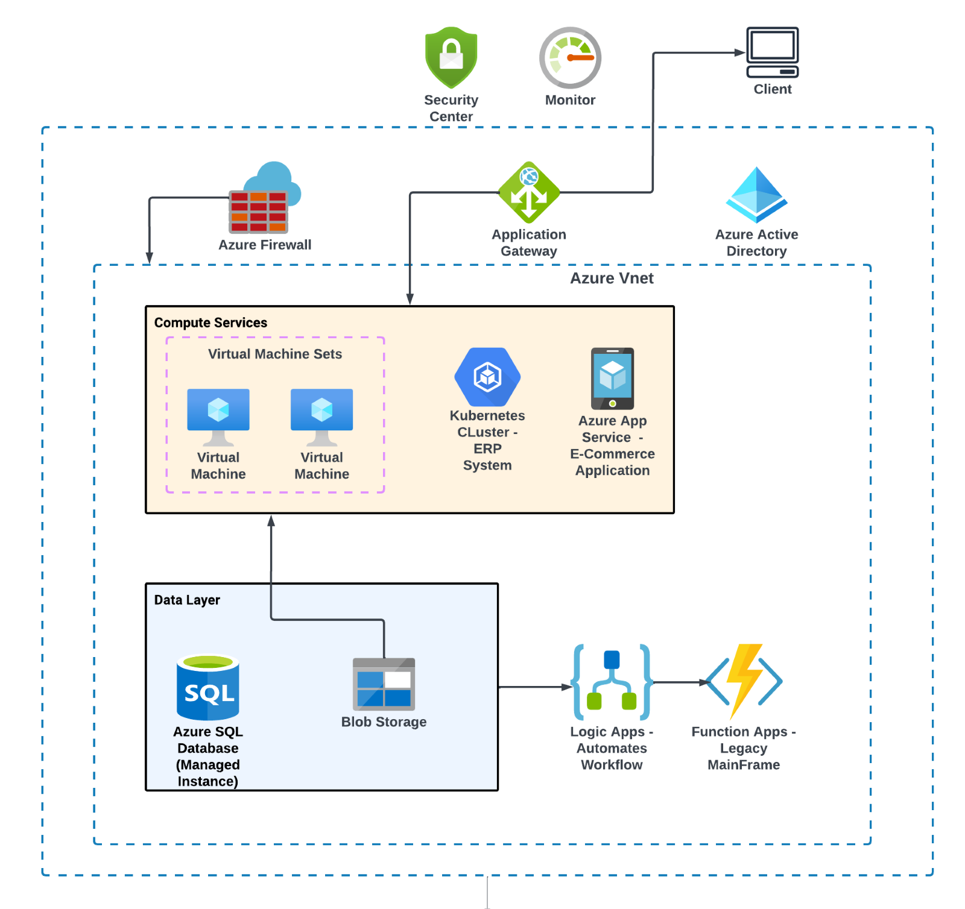
High-level architecture diagram

Slide 9
Address Legacy System Modernization
ERP Modernization (Refactor):
Break monolithic ERP into microservices hosted on Azure Kubernetes Service (AKS).
Replace legacy components with APIs (Azure API Management) and serverless functions (Azure Functions).
Improves scalability, performance, and adaptability.
Mainframe Modernization (Rehost & Modernize):
Lift-and-shift mainframe workloads to Azure Virtual Machines (VMs) using Azure Migrate.
Optimize networking with Azure Virtual Network (VNet) and Azure ExpressRoute.
Gradually modernize workflows using Azure Logic Apps and Azure Functions for automation.

Slide 10
Execution Phase – Migration Activities
Rehosting Virtual Machines (VMs):
Assess and migrate 150 VMs using Azure Migrate.
Configure Availability Sets and VM Scale Sets for scalability.
Implement Azure Site Recovery for real-time failover.
Refactoring the ERP System:
Break down monolithic ERP into microservices.
Deploy containerized services on Azure Kubernetes Service (AKS).
Migrate ERP data to Azure SQL Database Managed Instance.

Slide 11

Modernizing the Mainframe System:
Lift and shift mainframe workloads to Azure VMs.
Replace workflows with Azure Logic Apps and Azure Functions.
Database Migration:
Use Azure Database Migration Service for seamless transition.
Ensure data synchronization with Azure SQL Data Sync.
E-commerce Application Modernization:
Migrate to Azure App Service with Web App Migration Assistant.
Optimize routing with Azure Front Door and Application Gateway.
Data Migration:
Migrate data using Azure Storage Migration Tool.
Encrypt data with Azure Key Vault and set up automated backups.

Slide 12
Validation Phase – Ensuring Seamless Functionality
Functional Validation:
Test ERP functionality and database integrity.
Validate stored procedures, triggers, and data consistency.
Performance Testing:
Use Azure Load Testing for scalability testing of VMs and AKS.
Compare database query execution times with benchmarks.

Slide 13
Compliance Validation:
Engage users to validate ERP and e-commerce applications.
Post-Migration Optimization:
Ensure compliance with GDPR, HIPAA, and CCCS standards via Azure Policy
Conduct security audits using Azure Security Center.
Disaster Recovery Validation:
Simulate failovers with Azure Site Recovery to validate RPO/RTO.
Test backup/restore processes using Azure Backup.
User Acceptance Testing (UAT):
Address feedback to resolve post-migration issues.
Fine-tune resource configurations.
Decommission unused resources to optimize costs

Slide 14
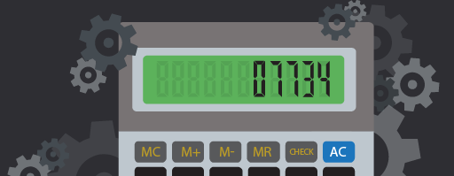
Cost Estimation
Resources | Estimated Monthly Cost
Compute (Virtual Machines) | $137,874.00
Databases | $21,624.55
ERP System | $2,752.83
E-commerce Applications | $388.39
Storage and Data Migration | $432.03
Networking and Security | $1,304.38
TOTAL | $164,376.21

Slide 15
Conclusion
- Migration Recap:
• Phased approach minimized risks and ensured smooth transitions.
• Legacy systems modernized for better performance and scalability.
- Key Outcomes:
• Enhanced security and compliance with Canadian and international standards.
• Cost-optimized infrastructure leveraging Azure's ecosystem.
• Cloud migration positions the company for innovation and global expansion.
• Leveraging Azure's tools for analytics and business intelligence.
- Future Growth:

